Slide 1
CMF Resources and Development Course
Daniel Carter
CMF Clearinghouse 2018 Webinar
Dec 17, 2018

Slide 2
Course on Developing CMFs
Enable you to develop and document quality CMFs
Application of various CMF development methods and appropriate documentation of CMF study results
Combination of self-paced, Web-based training and live instructor-led virtual classroom sessions

Slide 3
Course on Developing CMFs
4 week duration
Twice weekly instructor-led virtual classroom sessions with independent work between
Part 1: fundamentals of CMF development
Part 2: more advanced concepts and practice with employing the various methods

Slide 4
Course on Developing CMFs
NHI Course on Developing Quality Crash Modification Factors (FHWA-NHI-380119)
For more information, contact:
Karen Scurry
karen.scurry@dot.gov

Slide 5
Resources
CMF Clearinghouse User Guide
Compare CMFs tool
Excel download of search results

Slide 6
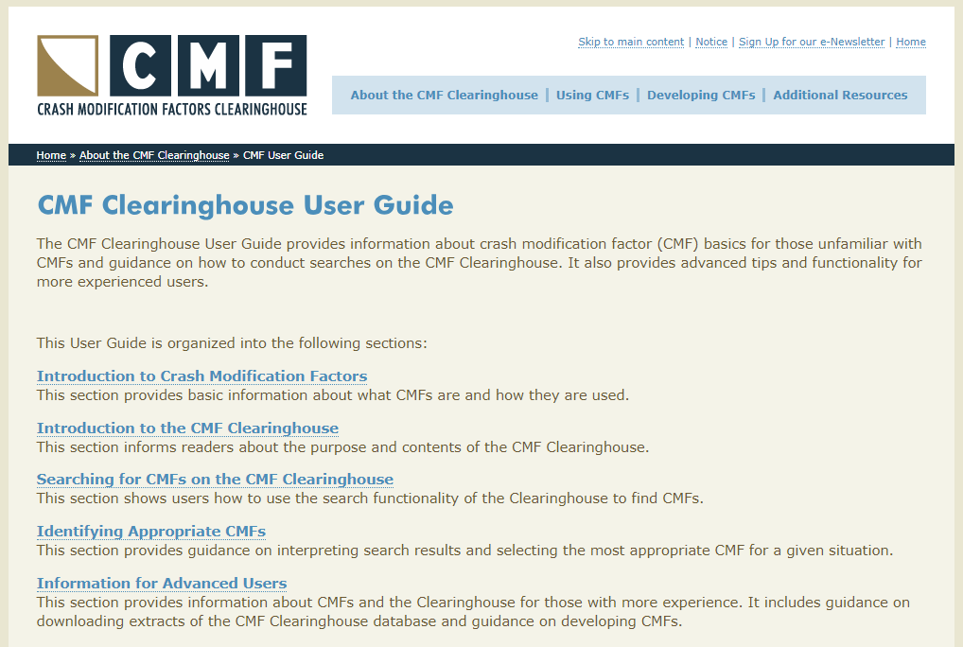
Resources: User Guide

Slide 7
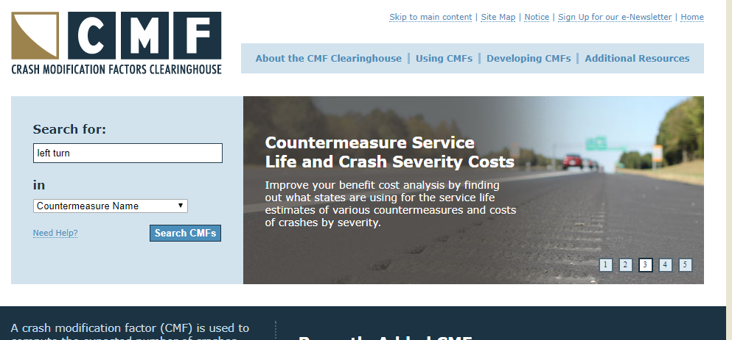
Resources: Compare CMFs Tool

Slide 8
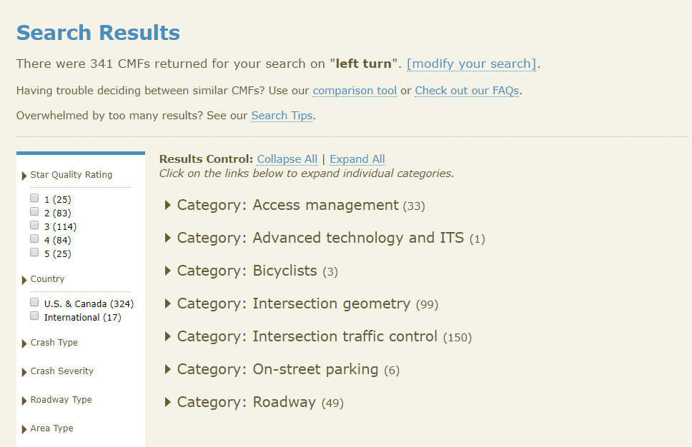

Slide 9
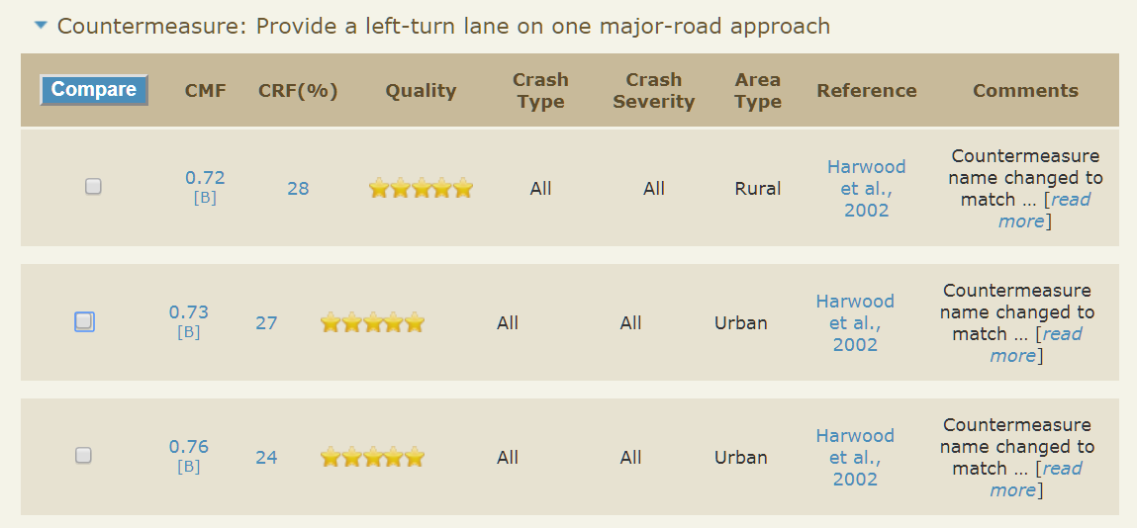
Resources: Compare CMFs Tool

Slide 10
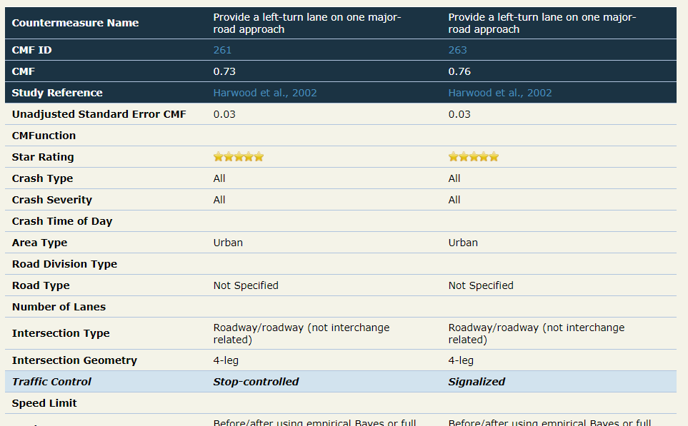

Slide 11
Resources: Excel Download
Allows processing of results in custom manner
Ex: Identify CMFs that used data from a particular state (roundabouts that used FL data)

Slide 12
Q&A
Enter questions on any of the presentations
Use the GoToWebinar window

